Slide 1


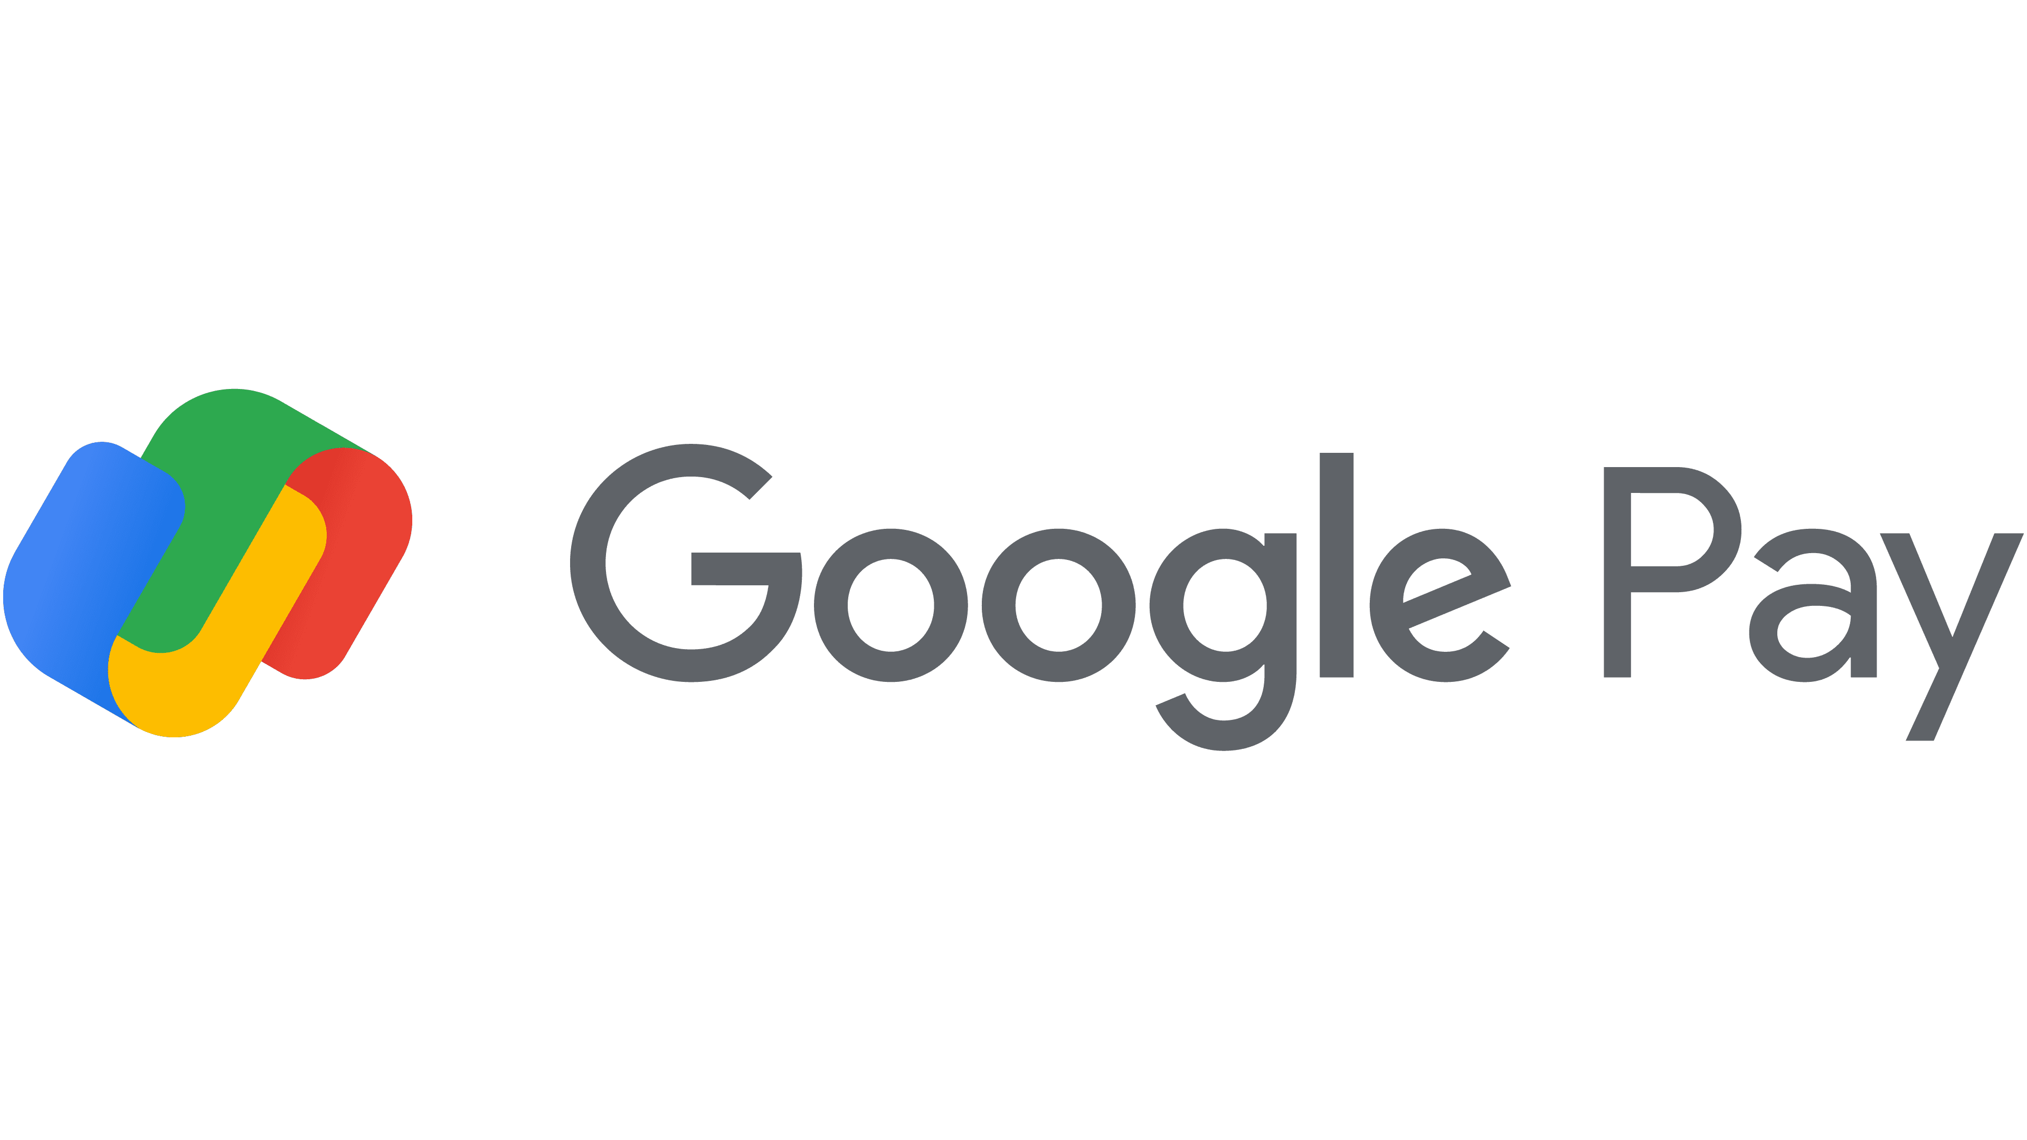



Slide 2
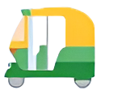

A digital wallet platform and online payment system developed by Google to power in-app, online, and in-person contactless purchases.
Introduced in January 2018, combining Android Pay and Google Wallet.

Slide 3
PRODUCT
PRODUCT
PROMOTION
PROMOTION
PLACE
PLACE
PRICE
PRICE

Slide 4
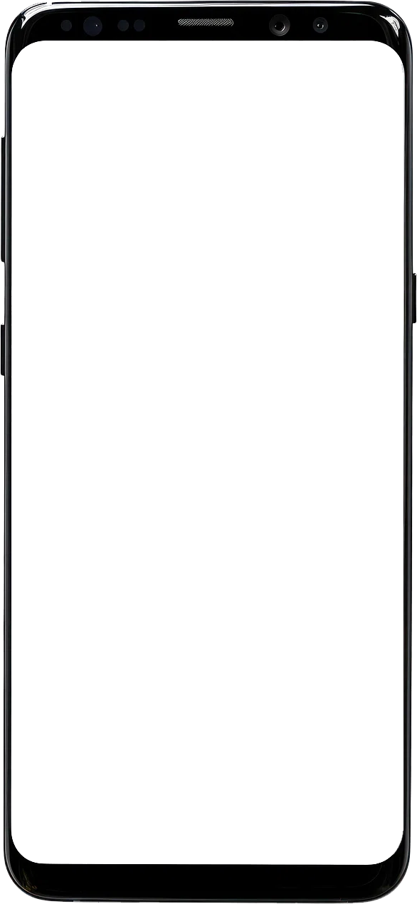
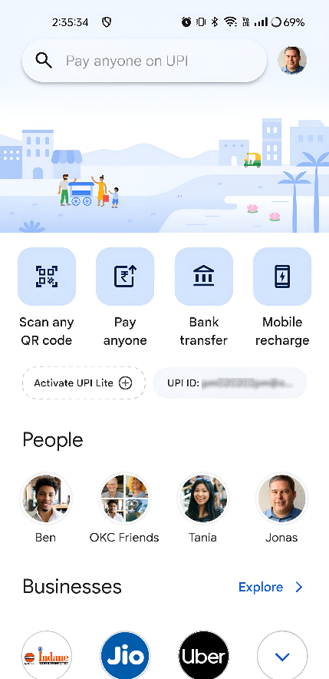
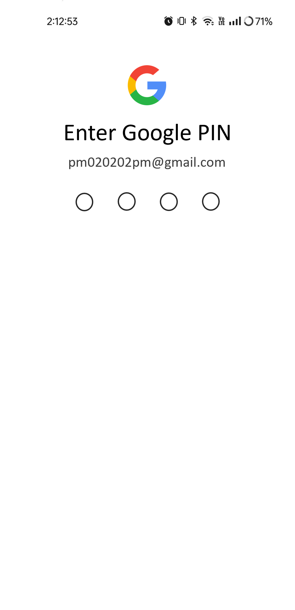
PROMOTION
PROMOTION
PRODUCT
PRODUCT
User-Friendly Interface: Intuitive and easy-to-navigate interface that simplifies the payment process.
PRICE
PRICE
Features of Google Pay
NFC Technology: Utilizes Near Field Communication (NFC) for contactless payments.
PLACE
PLACE
Cross-Platform Availability: Available on both Android and iOS devices.
Rewards and Offers: Cashback offers, discounts, and other promotional incentives to encourage usage.
Customer Service: Responsive customer service through various channels like chat, email, and phone.

Slide 5
PROMOTION
PROMOTION
PRODUCT
SECURE LOCK SCREEN
PRODUCT
PRICE
Tokenization
PRICE
Biometric authentication (fingerprint or face recognition)
PLACE
PLACE
Fraud protection.

Slide 6
QUICK ACCESS TO TOP PAYMENT OPTIONS
PROMOTION
PROMOTION
PRODUCT
Allows users to make contactless payments using their smartphones, eliminating the need for physical cards.
PRODUCT
PRICE
PRICE
PLACE
PLACE
PEER-TO-PEER PAYMENTS
Send and receive money instantly from friends and family.

Slide 7

PROMOTION
PROMOTION
PRODUCT
PRODUCT
PAY BILLS WITH EASE
PRICE
PRICE
Recharge mobile phones
PLACE
PLACE
Pay utility bills
FASTag recharge
Credit card bill payments
Pay to insurance, loan EMI, municipal tax and so on.

Slide 8
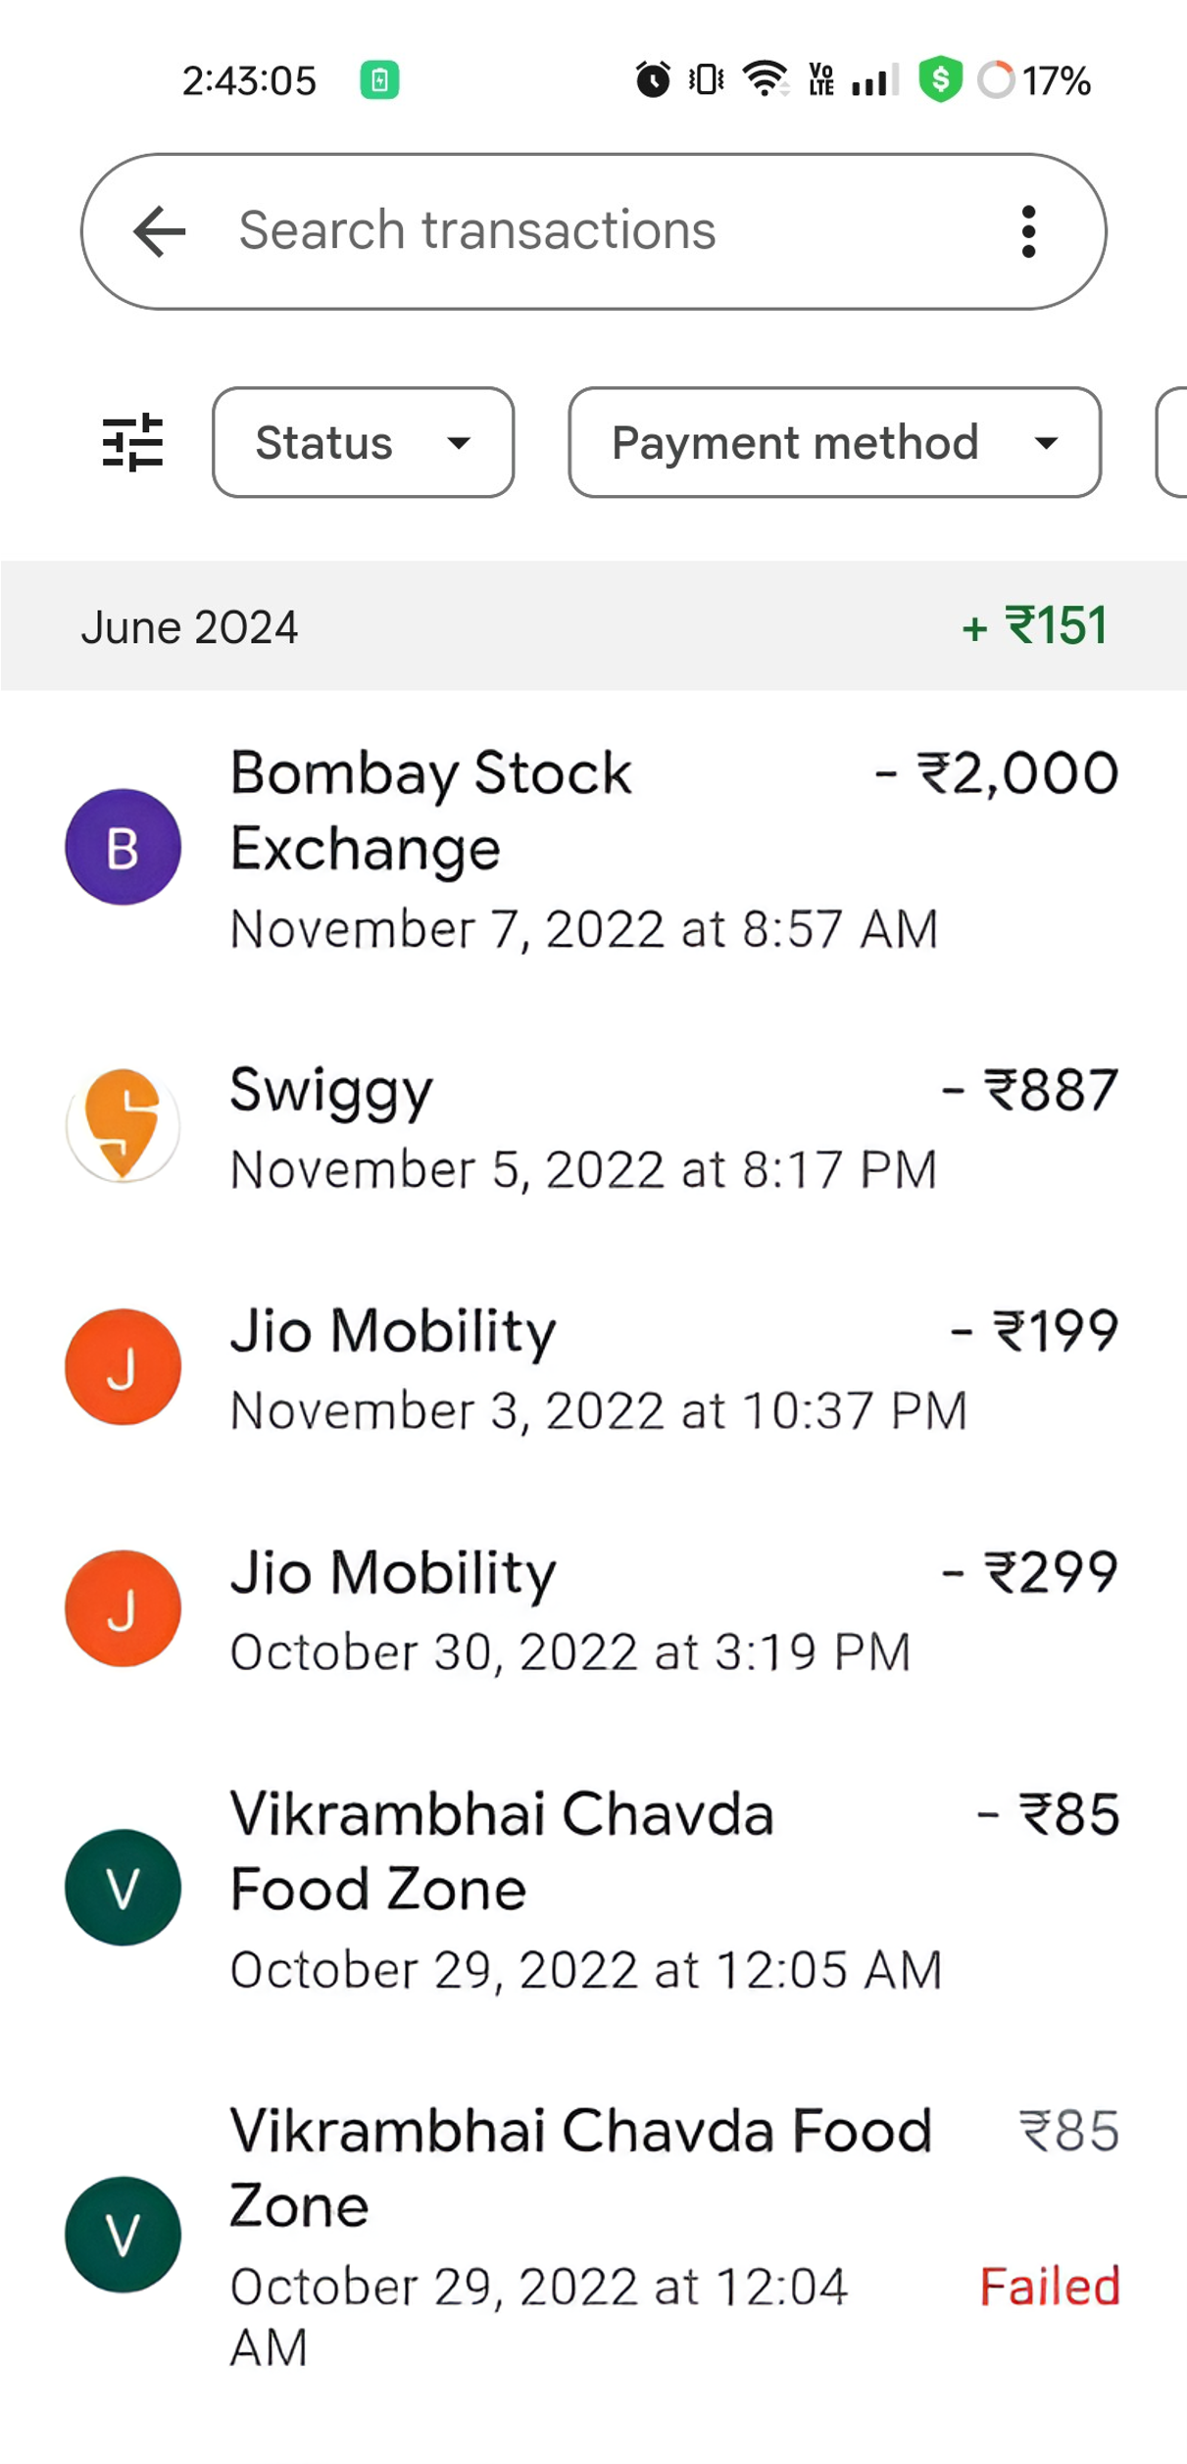
Check CIBIL Score on the go !
PROMOTION
PROMOTION
PRODUCT
PRODUCT
PRICE
PRICE
PLACE
PLACE

Slide 9
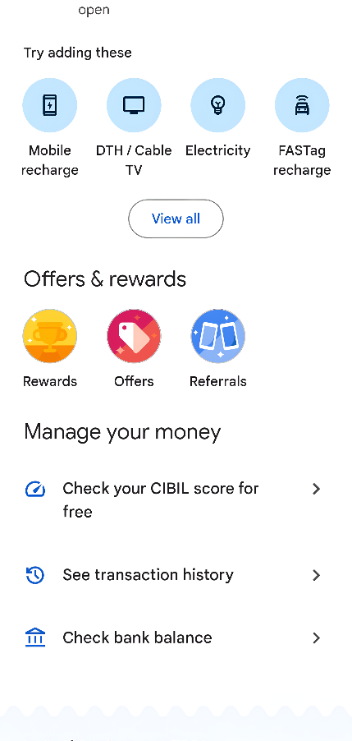
PROMOTION
PROMOTION
PRODUCT
PRODUCT
PRICE
TRANSACTION MANAGEMENT
PRICE
PLACE
Detailed transaction history.
PLACE
Enables Bill Splitting.

Slide 10
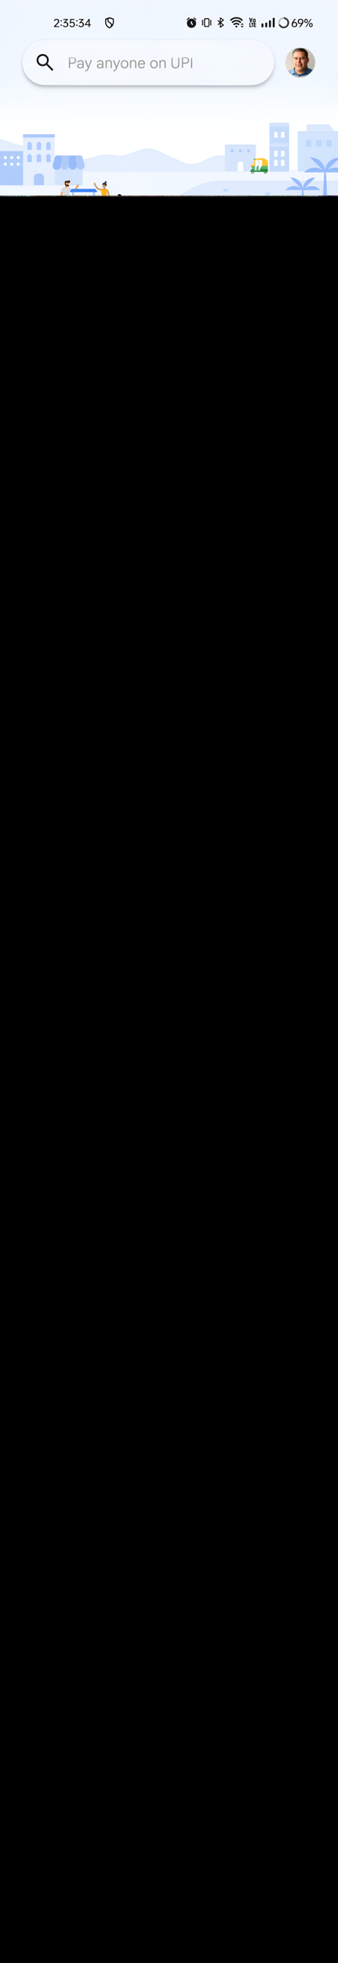
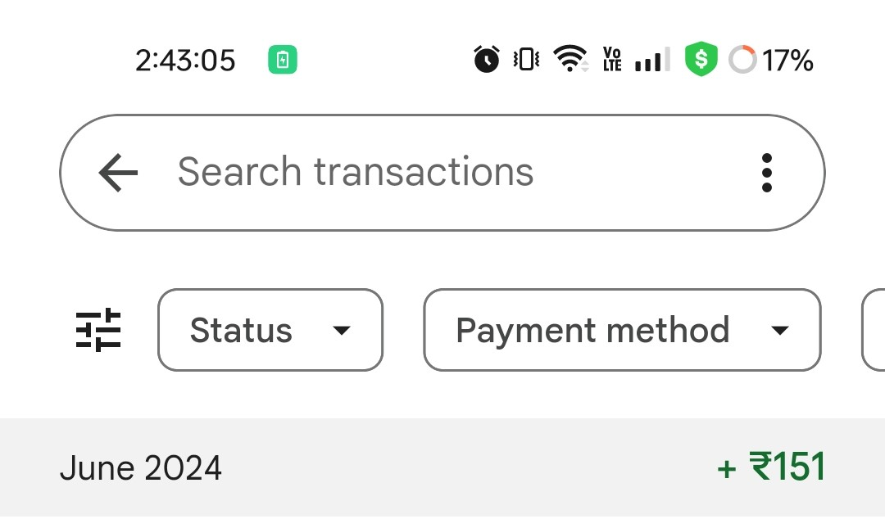
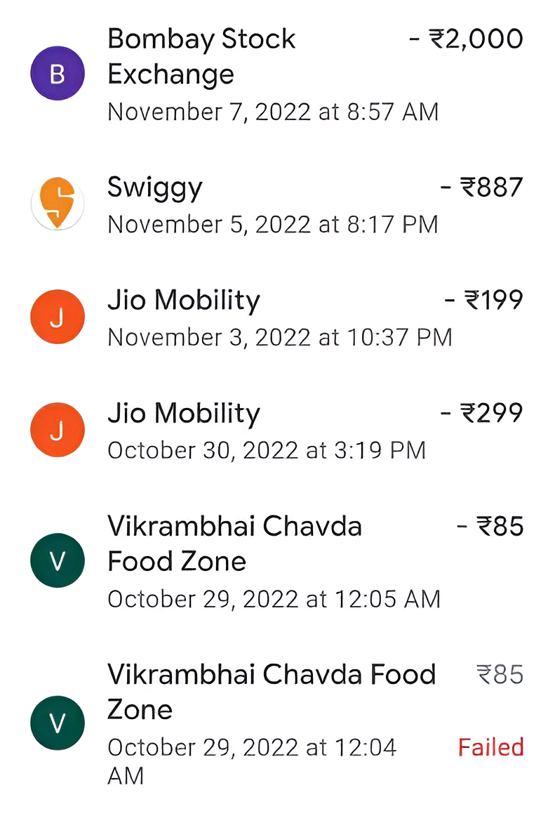

PLACE
PLACE
PRODUCT
PRODUCT
Accessible to a broad audience.
PROMOTION
PROMOTION
PRICE
PRICE
Ensures that payments and transfers are instantaneous.
How convenient is the delivery?
Users can make payments at a variety of locations.​
Users feel secure when making transactions.
Integrates with various other services.

Slide 11
PLACE
PLACE
PRODUCT
PRODUCT
Users can send money directly using their phone numbers or email addresses linked to GPay accounts.
PROMOTION
PROMOTION
PRICE
PRICE
Delivery Channels of GPay
Making payments using QR codes, NFC, and UPI.
Making payments for online shopping on websites and apps that support Google Pay.
Paying utility bills, including electricity, water, gas, and mobile recharges, directly through the app.

Slide 12

PLACE
PLACE
PRODUCT
PRODUCT
Fees charged to merchants are competitive compared to other payment gateways.
PROMOTION
PROMOTION
PRICE
PRICE
Are they cost effective?
Users often save money through various cashback and discount offers.
Businesses can reduce the need for physical payment infrastructure (like card machines).

Slide 13



PRICE
PRICE
PLACE
PLACE
They don’t directly earn from their users!
PRODUCT
PRODUCT
How do Google Pay make money?
PROMOTION
They won’t charge you when you send money to other users.
PROMOTION
They won’t charge you on paying bills.
No charge on Tap and Pay feature usage.
See your CIBIL score at no extra cost!

Slide 14

PRICE
PRICE
PLACE
PLACE
PRODUCT
PRODUCT
They do earn a lot…
PROMOTION
PROMOTION
Google Payment India reports ₹14.8 crore revenue in FY 21
Mumbai, October 19
Google Payment India Private Limited reported its revenues for the financial year 2020-21 as ₹14.8 crore. The company further reported a net profit of ₹1.4 crore during the same fiscal. This is a 210 per cent increase from the last financial year.

Slide 15



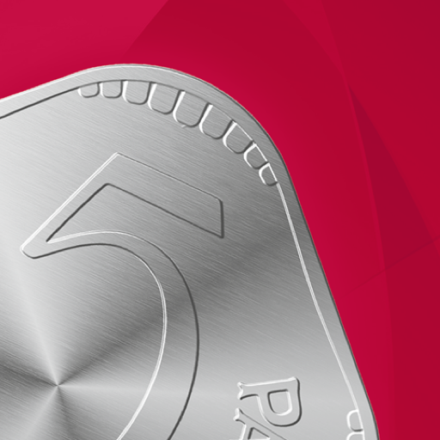
PRICE
PRICE
PLACE
PLACE
Biggest source of revenue is the collaboration with brands.
PRODUCT
PRODUCT
Let’s decode, how do they earn!
PROMOTION
PROMOTION
Apart from that, platform fee on mobile recharges.
Ranges from ₹1 to ₹3, depending on recharge value.
Subscription fees on SoundPod from merchants.

Slide 16
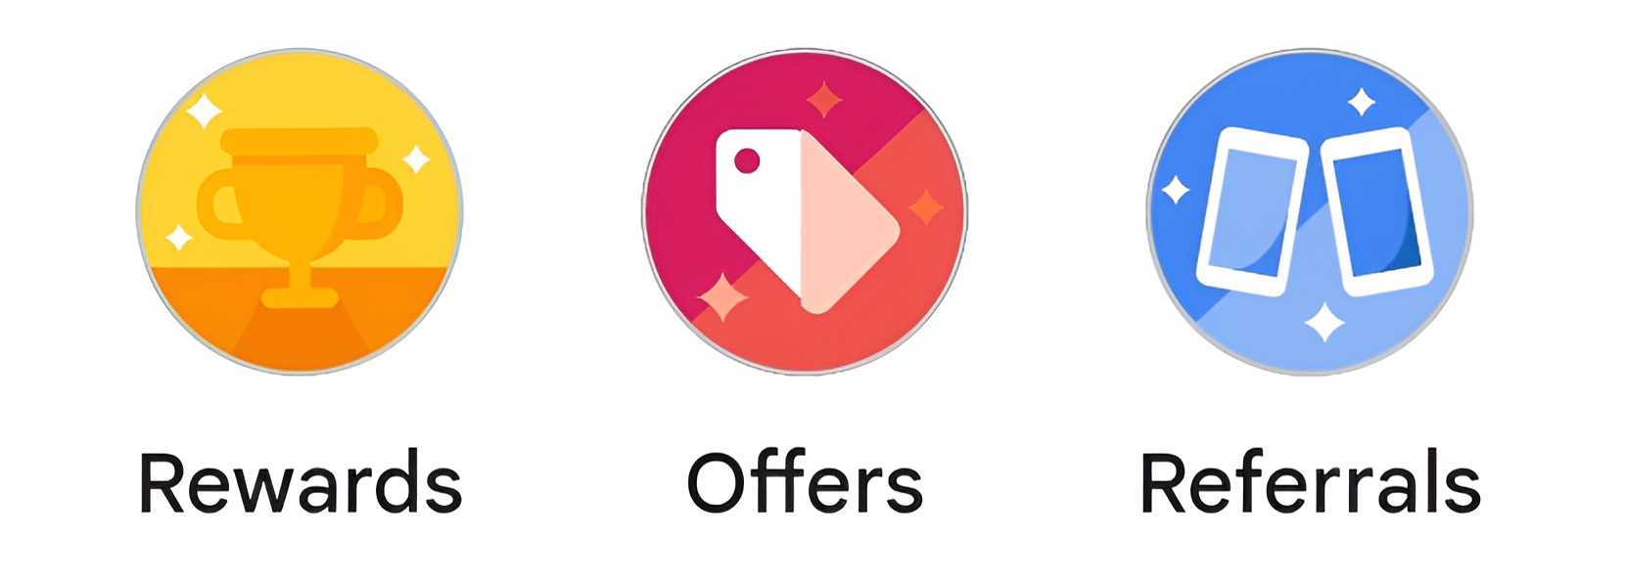

PRICE
PRICE
PLACE
PLACE
What else can be done to
increase revenue?
Apple Pay was able to negotiate a fee from each transaction in the US.
Precisely 0.15% from credit card and 0.5% from a debit
card.
PRODUCT
PRODUCT
PROMOTION
PROMOTION
Google Pay has the same opportunity as Apple Pay to charge users.
In-app advertisements can be another way to earn.

Slide 17







PRICE
PRICE
Viral Marketing and Gamification
by Google Pay
PROMOTION
PROMOTION
Involves spreading a message rapidly across audiences via social shares, likes, and comments.
PLACE
PLACE
PRODUCT
PRODUCT
Unlike traditional emotional or humorous advertisements, Google Pay opts for gamification to engage users.
#Rangoli Diwali and the ongoing #GoIndia campaigns, both of which significantly increased user engagement and brand visibility.

Slide 18






PRICE
PRICE
PROMOTION
PROMOTION
Target Audience: Focused on younger demographics, ages 17-30, known for their responsiveness to interactive digital content.
Campaign Mechanics: Users explore virtual cities in India through the app, aiming to visit all 30 cities by a set date to win cash rewards ranging from Rs. 101 to Rs. 501.
PLACE
PLACE
PRODUCT
PRODUCT
Engagement Techniques: Incorporation of features like city ticket collection and kilometers needed to travel, encouraging regular interaction with the app.

Slide 19
Psychological Drivers and User Engagement Strategies
PRICE
PRICE
PROMOTION
PROMOTION
Network Effect: Encourages sharing among peers with features allowing users to gift or request city tickets, effectively pulling back lapsed users and attracting new ones.
PLACE
PLACE
Reward System: Utilizes a variable reward structure to maintain excitement and engagement, focusing users on the potential maximum reward.
PRODUCT
PRODUCT
Sense of Accomplishment: Leaderboards spark competitive spirits.
Fear of Missing Out (FOMO): Creates a social pressure to participate, as users see their friends advancing.

Slide 20
CAMPUS SURVEY
56
TOTAL RESPONSES

Slide 21
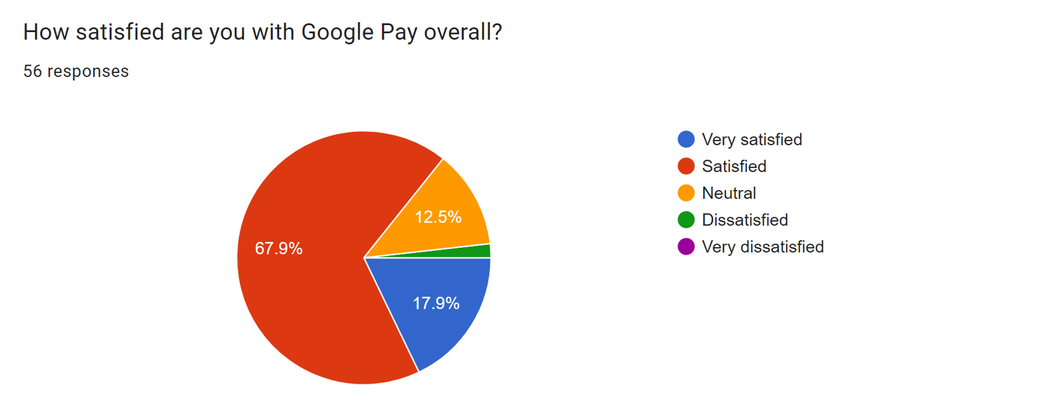
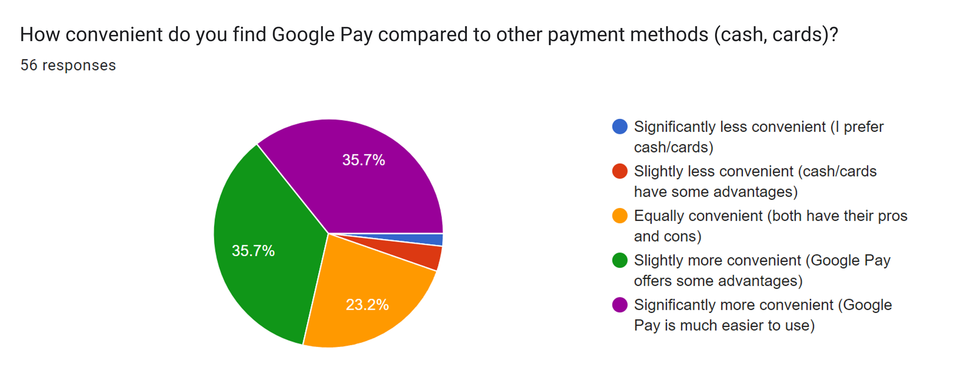
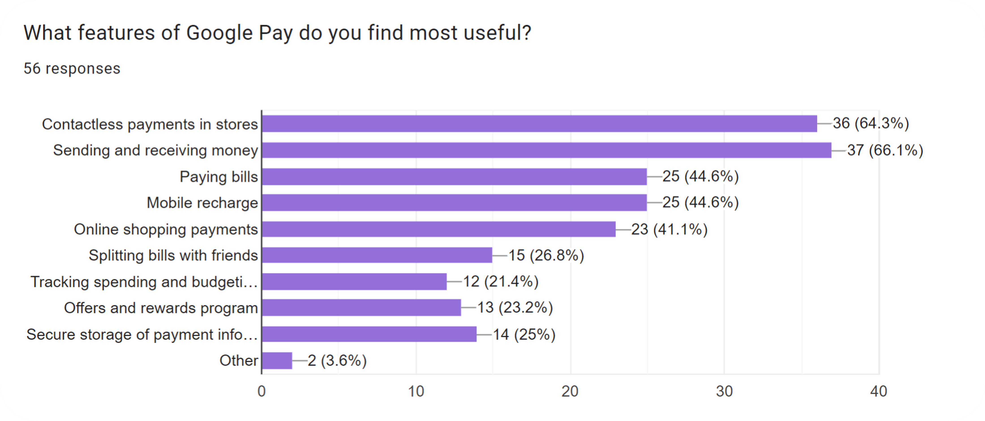
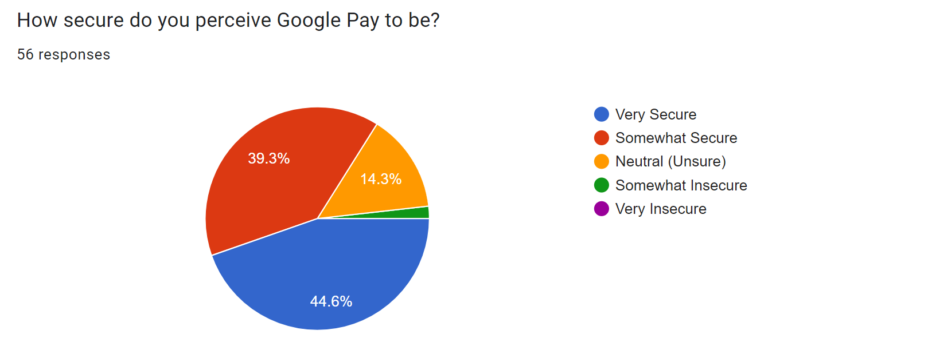
CAMPUS SURVEY RESULTS

Slide 22
CAMPUS SURVEY RESULTS

Slide 23
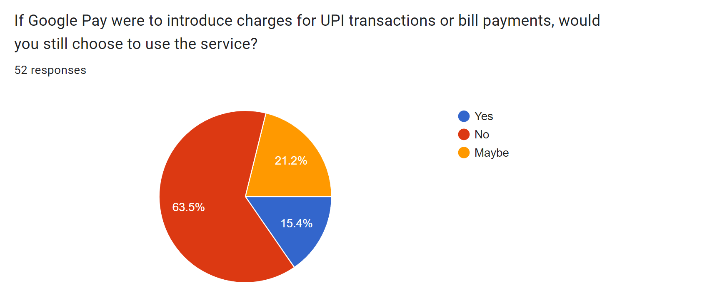
CAMPUS SURVEY RESULTS

Slide 24
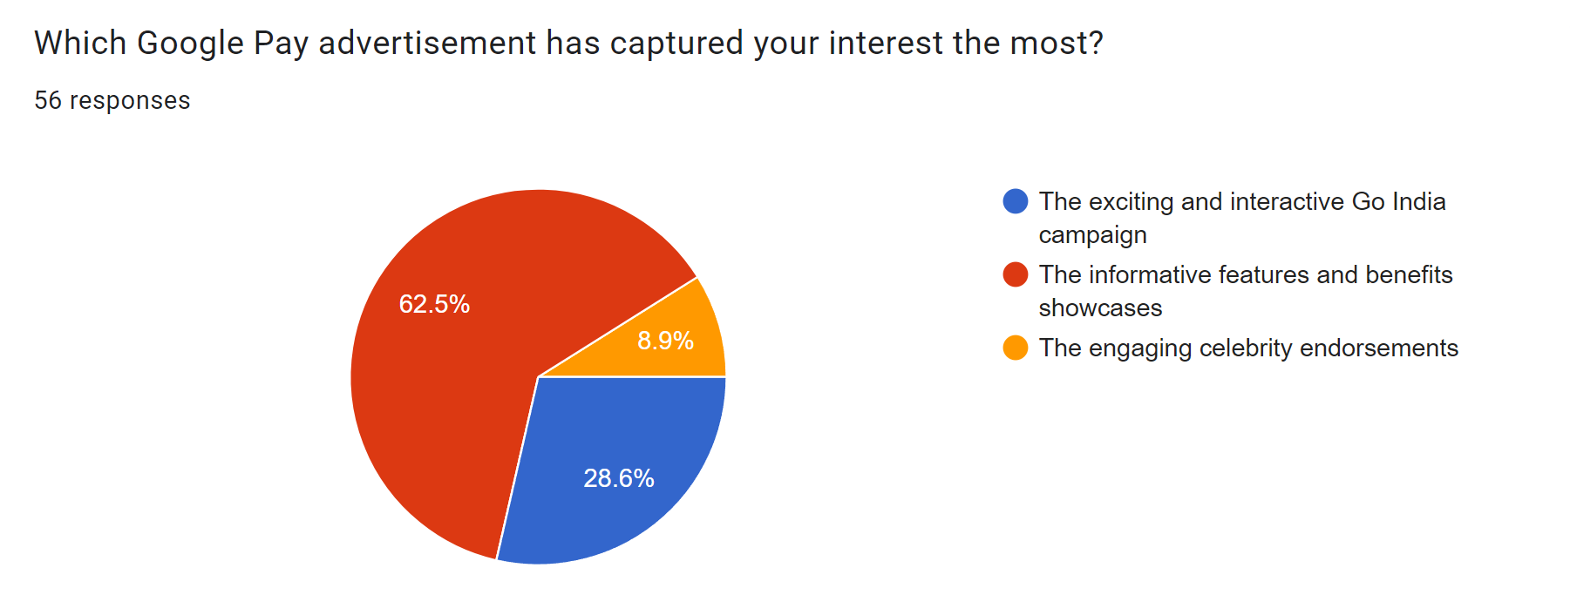
CAMPUS SURVEY RESULTS

Slide 25
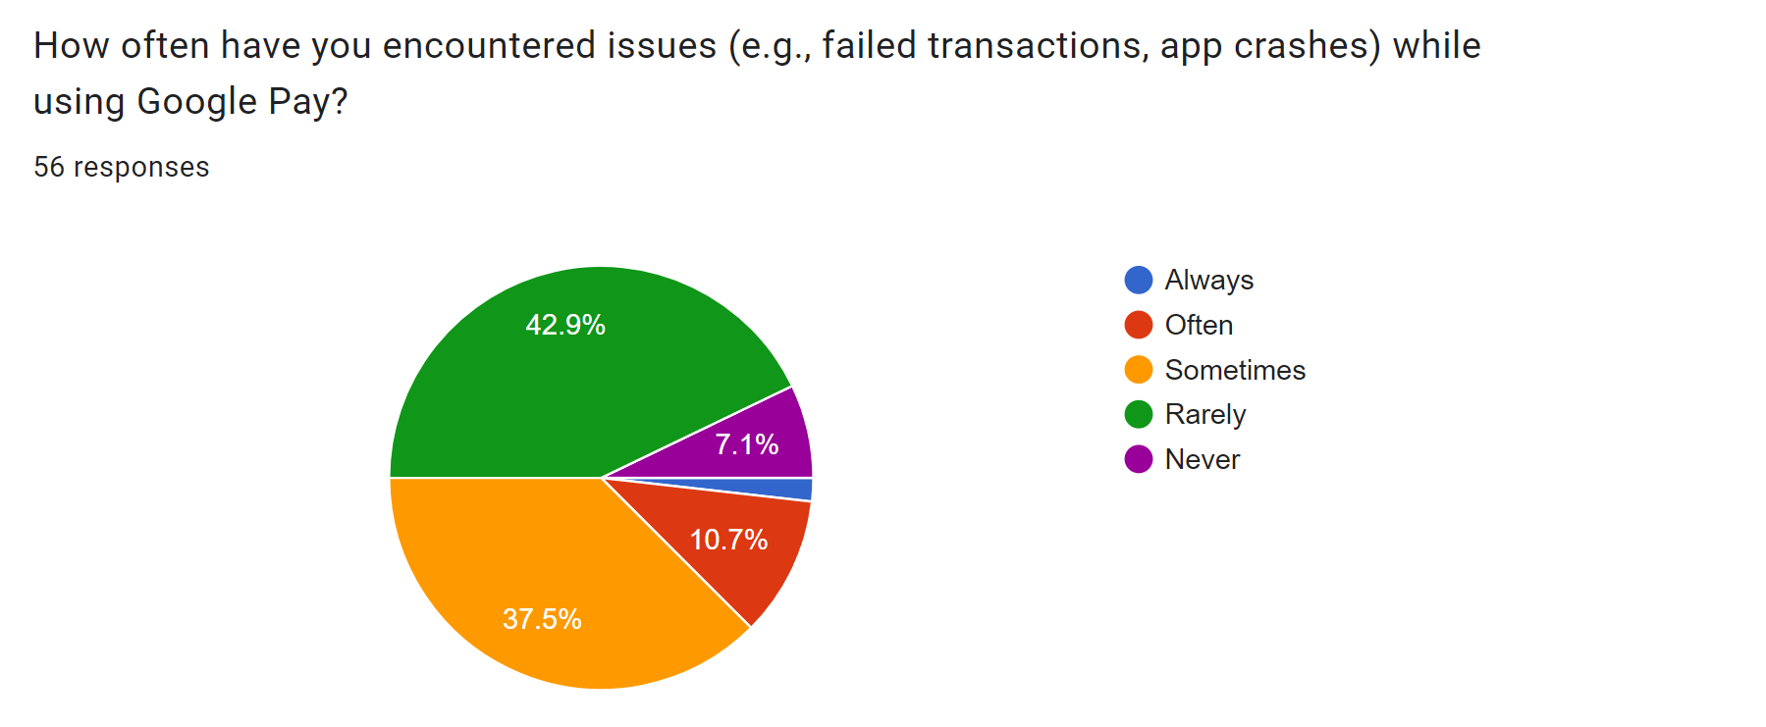
CAMPUS SURVEY RESULTS

Slide 26
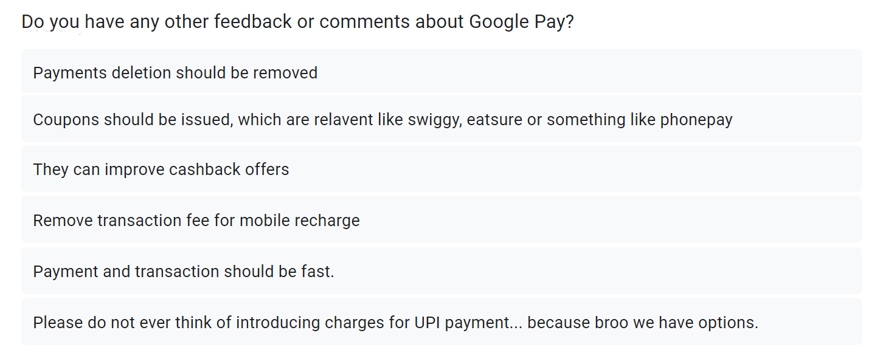
CAMPUS SURVEY RESULTS

Slide 27
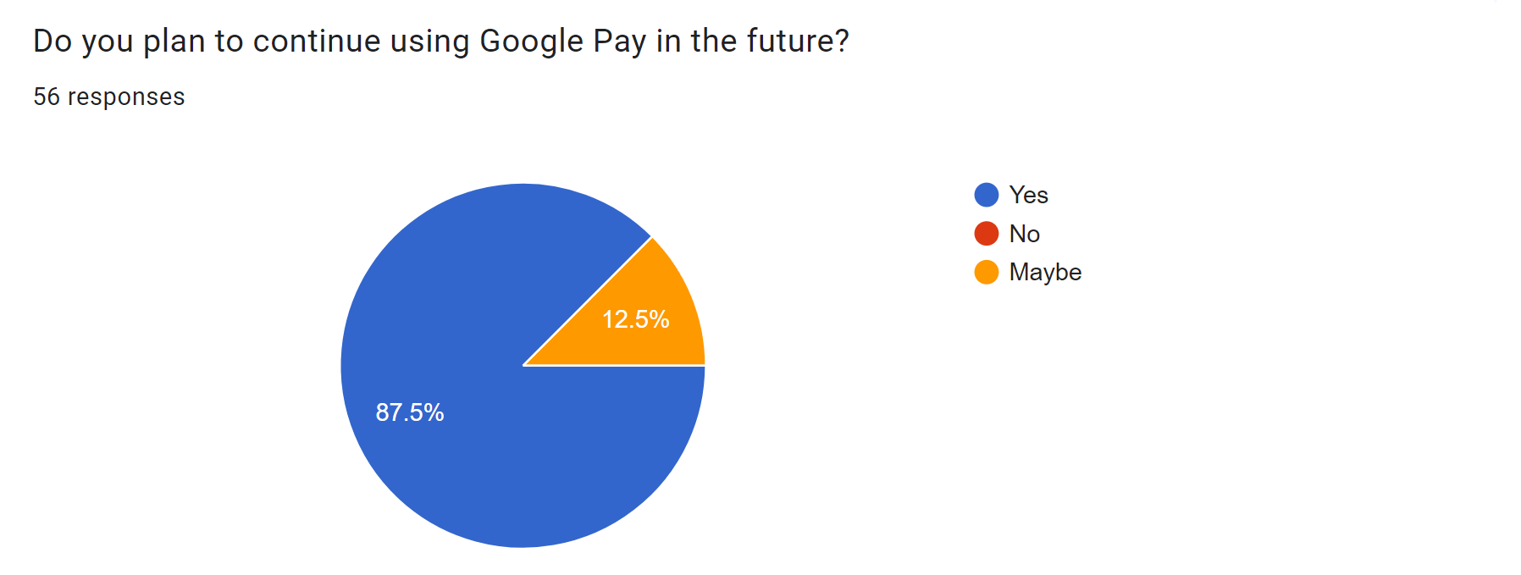
CAMPUS SURVEY RESULTS

Slide 28
CAMPUS SURVEY RESULTS

Slide 29
CAMPUS SURVEY RESULTS

Slide 30
4P ANALYSIS AFTER SURVEY

Slide 31
PRODUCT
Allowing users to customize their dashboards.
Integrate options for users for investments.
PLACE
Add options to book movies tickets, flights, train tickets, etc.
PRICE
Accessibility Improvements:
PROMOTION
Expand language support to cater to a broader audience.
Enhance accessibility features for users with disabilities.

Slide 32
PRODUCT
Make some app features available via website.
PLACE
Access to certain app features such as in-store payment, in absence of internet.
PRICE
Integrate Google Pay with more e-commerce platforms, ride-sharing apps, and local services.
PROMOTION

Slide 33






PRODUCT
Remove platform fee on mobile recharges.
PLACE
Banner ads can be a better way to earn.
PRICE
Implement dynamic pricing models for high-volume users or businesses, providing tailored pricing options based on usage patterns.
PROMOTION

Slide 34

THANK YOU
THANK YOU
Priyanshu Maurya, 220827
PRODUCT
Launch campaigns to educate users on the security and convenience of digital payments.
Vasudeva H N, 221175
PLACE
Chunduri Nishanth, 220318
Sponsor local events, workshops, and webinars to promote digital literacy and the benefits of using Google Pay.
Shreya Verma, 211003
PRICE
Varsha Khandelwal, 221171
Ayush Pratap Singh, 220270
PROMOTION
Use data analytics to offer personalized promotions based on user behavior and preferences.

Slide 35
THANK YOU
THANK YOU
Priyanshu Maurya, 220827
Vasudeva H N, 221175
Chunduri Nishanth, 220318
Shreya Verma, 211003
Varsha Khandelwal, 221171
Ayush Pratap Singh, 220270

